Slide 1
Trade Tensions in the Time of Trump
Alan V. Deardorff
University of Michigan
May, 2018

Slide 2
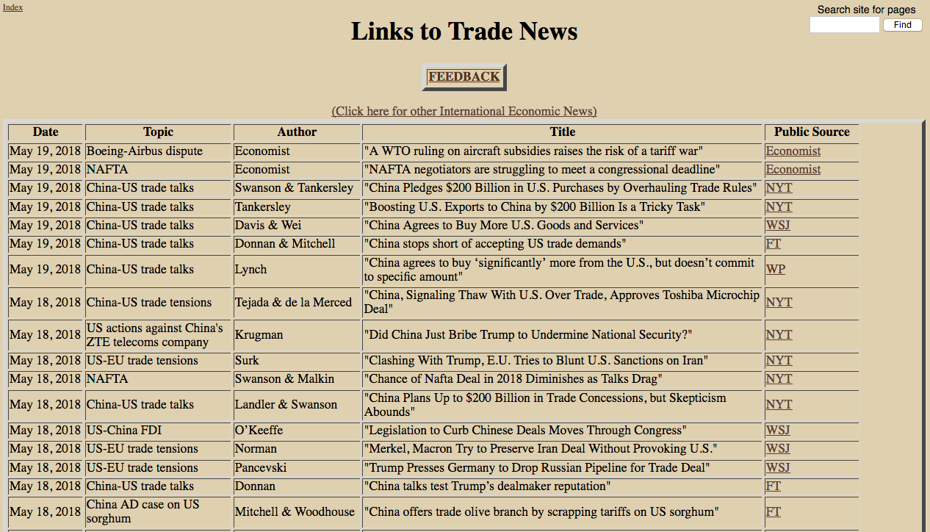

Slide 3
From FT, WSJ, NYT, WP, Economist as linked to on
http://www-personal.umich.edu/~alandear/news/TradeNews.html

Slide 4
1-8/2015
Greece Crisis
2011-2013
Eurozone Crisis
From FT, WSJ, NYT, WP, Economist as linked to on
http://www-personal.umich.edu/~alandear/news/TradeNews.html

Slide 5
Nov 7-13, 2016
Trump elected
Jan 16-22, 2017
Trump inaugurated
Mar 1, 2018
Trump announces metals tariffs
Jun 20-26, 2016
Brexit
From FT, WSJ, NYT, WP, Economist as linked to on
http://www-personal.umich.edu/~alandear/news/TradeNews.html

Slide 6
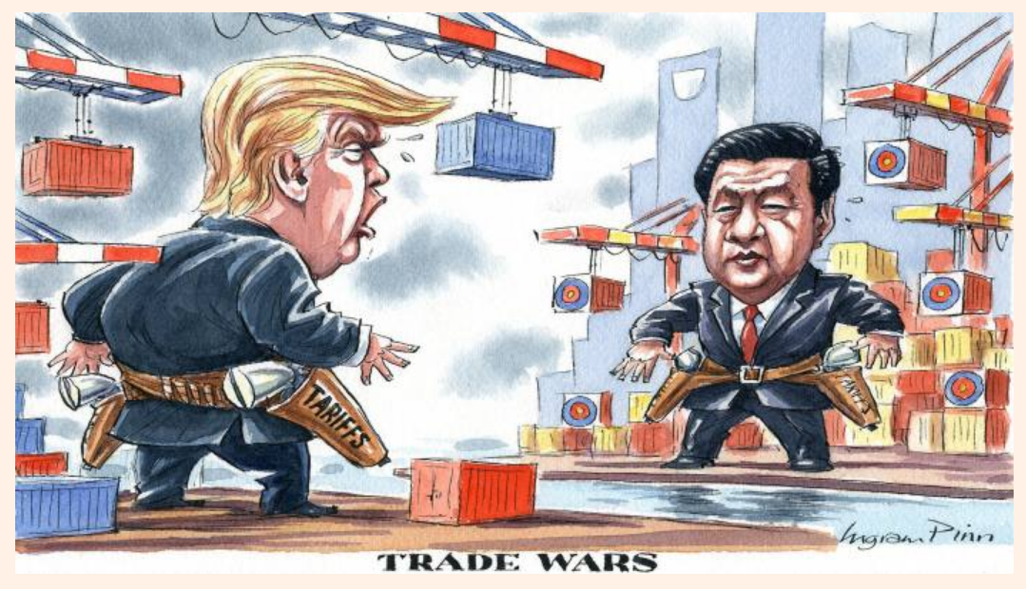
Ingram Pinn, Financial Times, April 6, 2018

Slide 7
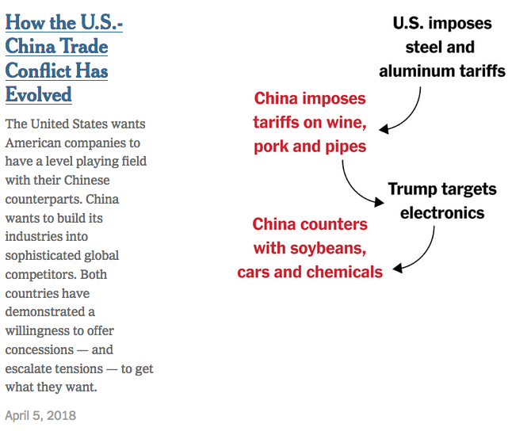
Source: Swanson & Tankersley (2018)
Notes:
Swanson, Ana and Jim Tankersley, “China Pledges $200 Billion in U.S. Purchases by Overhauling Trade Rules,” New York Times, May 18, 2018. (But apparently taken from earlier April 5 piece, but I don’t know what.)

Slide 8
Outline
Timeline of events
TPP
NAFTA
Safeguards
Trade deficits
Steel & Aluminum
China
WTO

Slide 9
Timeline of Trade Policy under Trump
CVD case begun under Obama
Actions taken in 2017
Jan 23: Trump pulls out of TPP
Apr 3: Trump signs 2 executive orders on trade
Apr 24: 20% tariff on Canada softwood lumber*
May 18: US launches NAFTA renegotiation
Oct 5: Negotiation began to amend US-Korea FTA

Slide 10
Trade Policy under Trump
Actions taken in 2018
Jan 21: Safeguard tariffs on solar panels and washing machines
Mar 1: Announces 25% tariff on steel; 10% on aluminum on all countries
Mar 23: Steel and aluminum tariffs begin, exempting: Canada, Mexico, EU, Australia, S. Korea, Brazil, Argentina (not Japan) until May 1

Slide 11
Trade Policy under Trump
March 2018
Mar 22: Trump announces tariffs on $50-60 billion of China exports (details announced Apr 2)
Mar 22: China threatens tariffs on $3 billion of US exports
Mar 27: Amended KORUS signed (extends tariffs and reduces trade)
Mar 29: US suspends duty-free access for apparel from Rwanda

Slide 12
Trade Policy under Trump
April 2018
Apr 1: China announces tariffs on 128 US exports
Apr 6: Trump threatens tariffs on another $100 billion of China exports. China threatens to hit back.
Apr 7: Trump considers stricter environmental enforcement for imported cars
Apr 12: Trump considers rejoining TPP
Apr 17: He changes his mind
Apr 16: US acts against China’s ZTE telecoms company for selling to Iran & N. Korea
Apr 17: China AD case on US Sorghum adds 179% deposit
May 18: China drops the case and removes the tariff

Slide 13
Trade Policy under Trump
May 2018
May 1: Trump extends metals tariff exemptions for 30 more days for EU and other allies
May 3-5: Seven US trade negotiators meet with officials in Beijing. No agreement results.
May 7: In NAFTA negotiation, US asks for minimum wage for auto workers
May 10: China’s ZTE halts operations
May 14: Trump says he’ll protect ZTE jobs in China
May 17-19: China’s Liu He meets in Washington with Treasury Secretary Mnuchin
May 19: China promises to increase imports from US by $200 billion
May 24: Trump initiates national security investigation of auto imports

Slide 14
TPP
12-country FTA negotiated un Obama but not ratified by Congress
Trump said he’d pull out and he did, on first full day in office
Later said he’d like to rejoin, but changed his mind after a few days
Meanwhile, the 11 other countries renegotiated TPP as
Comprehensive and Progressive Agreement for Trans-Pacific Partnership (CPTPP)

Slide 15
NAFTA
Trump opposed from before it was enacted:
1993: “The Mexicans want it, and that doesn't sound good to me.”
2016: “The single worst trade deal ever approved in this country”
Threatened (repeatedly) to pull out, but is currently “renegotiating”

Slide 16
NAFTA Renegotiation
Began Aug 16, 2017
Intended to finish before now
US eager to finish soon, before
Trade Promotion Authority (Fast Track) expires July 1
Mexico’s presidential election, July 1
US midterm elections, November but primaries already underway

Slide 17
NAFTA Renegotiation
Issues
Auto trade
Rules of origin
Wages
Sunset clause
Dispute settlement mechanism
Investor-state (Chapter 11)
AD/CVD (Chapter 19)

Slide 18
Safeguards
Implemented safeguard tariffs (US 201, or Escape Clause)
30% on solar panels
50% on washing machines
(both declining over 4 years)
Both follow prior anti-dumping actions that had been circumvented
President had option not to use

Slide 19
Trade Deficit(s)
Trump’s primary objection is to US trade deficits, bilateral and overall
Says they mean “US is losing in trade”

Slide 20
Quote from Trump
Told by Canada's Justin Trudeau that Canada doesn’t have a trade surplus with the US, Trump says "I said, 'Wrong, Justin, you do.' I didn’t even know. I had no idea."
In fact, by US data, the US has a surplus with Canada in goods and services, but a deficit if you count only goods. 2017, $billions:
Goods: –17.5
Goods and services: +2.8
As economists explain, there is no reason why countries’ trade should balance, especially bilaterally, under either measure.

Slide 21
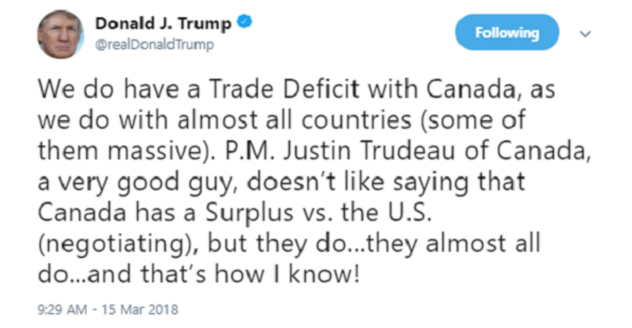
Quote from Trump:

Slide 22
Is he right about “almost all countries”?
US Census reports goods trade balances of US with 234 countries for 2017. US has
Surpluses with 130
Deficits with 104
But with our top-10 trading partners (ranked by exports plus imports) we have a surplus with only one: U.K.
Of our top 50 partners, we have surpluses with only 36%

Slide 23






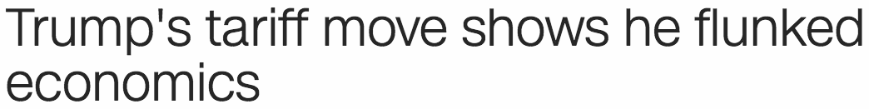
Steel and Aluminum
Legality under WTO doubtful
Mar 1: 25% tariff on steel; 10% on aluminum
Based on “national security”
Mar 2:
Mar 2:
Mar 2:
Mar 2:
Mar 3:
Mar 3:

Slide 24


Steel and Aluminum
Mar 8:
Mar 8: Trump metals tariffs to start in 15 days, exempting Canada and Mexico
Mar 22: Also exempts other allies EU, Australia, S. Korea, Brazil, Argentina (not Japan)
Mar 23: Tariffs go into effect, mostly on China and Russia

Slide 25
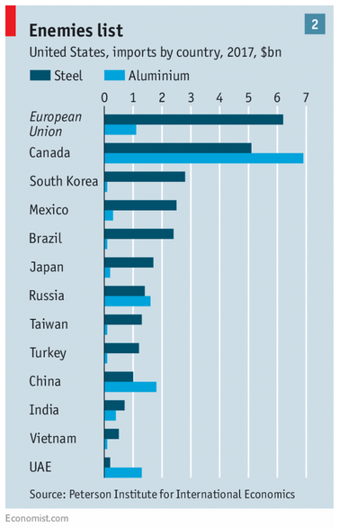
×
×
×
×
×

Slide 26
Steel and Aluminum
May 1: Exemptions extended late on Apr 30
30-day exemption for EU, Canada, Mexico, during which US will negotiate for possible permanent exemption
Canada & Mexico as part of NAFTA talks
EU, US is pushing for quotas
US has “agreement in principle” with Argentina, Australia, and Brazil, for permanent waivers if finalized
S. Korea got permanent exemption with amended KORUS FTA (in return for promise to cut steel exports to 70% of 2017 levels)

Slide 27
China
Mar 22: Trump announces tariffs on $50-60 billion of China exports
Mar 22: China threatens tariffs on $3 billion of US exports
Apr 1: China announces tariffs on 128 US exports
Apr 6: Trump threatens tariffs on another $100 billion of China exports. China threatens to hit back.

Slide 28
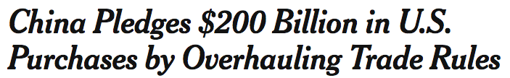
China
May 3-5: Negotiations in Beijing
May 17-19: Negotiations in Washington
May 19:
Related US-China issues
ZTE
China sorghum imports
Intellectual property theft
Joint-venture requirements

Slide 29
World Trade Organization
Trump has not (yet) taken much direct action against the WTO. But he has ignored and weakened it.
WTO is
Agreement among member countries not to use trade policies against each other except under specified rules
Forum for negotiation to resolve disputes and liberalize trade
WTO superseded GATT which stopped the pre-WWII chaos of trade policy

Slide 30
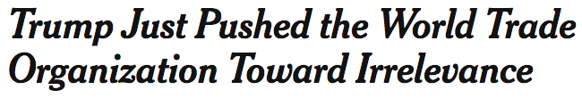
World Trade Organization
Trump’s actions
Blocked replacements on WTO Appellate Body
Though that was done first by Obama
Threatened tariffs on China ignoring WTO rules
Mar 23, 2018:
He prompts others to ignore WTO rules
Mar 6, 2018:

Slide 31
Concerns Going Forward
Tariffs will cause harm
Supply chains that expanded will be broken
Trade war
Tariffs, retaliation, and counter-retaliation will push both trade and the world economy into recession or depression
WTO will cease to matter and world trading system will revert to rule by the strong
That may have worked in the 1980s, when US and EU agreed and were dominant
It won’t work now with China an equal power

